Slide 1
UPPER SIXTH ARTS
GEOGRAPHY
Lesson 18
Theories of Population and Resources: Malthus and Boserup
Notes:
Good morning, class, and welcome to our geography lesson. I am your geography teacher, Mr Kamdem. Today we are starting Lesson 18: Theories of Population and Resources: Malthus and Boserup.

Slide 2
CLASS INFO
Class, Chapter and Duration
Class | Upper Sixth Arts
Chapter | Module 4: Understanding and managing population dynamics across the world in general and Cameroon in particular
Duration | 2 periods (2 × 50 minutes)
Notes:
This lesson is for Upper Sixth Arts. It belongs to Module 4: Understanding and managing population dynamics across the world in general and Cameroon in particular. We shall need 2 periods to cover it.

Slide 3
IDENTIFICATION
Lesson Identification
Topic | Population Growth and Resources
Sub-topic | Theories of Population Growth and Resources
Lesson | Lesson 18: Theories of Population and Resources: Malthus and Boserup
Notions / Concepts | Pessimistic view, optimistic view, geometric growth, arithmetic growth, checks, agricultural intensification, innovation.
Syllabus focus | General views on population and resources; the Malthusian theory, its strengths and weaknesses; Boserup's theory, its strengths and weaknesses; comparison and application today.
Competence | Learners are able to explain, compare and criticise the theories of Malthus and Boserup and apply them to North Cameroon.
Notes:
Our topic is Population Growth and Resources, and the sub-topic is Theories of Population Growth and Resources. The key notions we shall use today are: pessimistic view, optimistic view, geometric growth, arithmetic growth, checks, agricultural intensification, innovation. At the end, you should be able to do this: learners are able to explain, compare and criticise the theories of Malthus and Boserup and apply them to North Cameroon.

Slide 4

HOMEWORK CORRECTION
Correction of the Homework
Question (Lesson 17: Overpopulation, Underpopulation and Optimum Population):
Give the date of Malthus's essay on population.
Notes:
Before we start the new lesson, let us correct the homework I gave you at the end of Lesson 17: Overpopulation, Underpopulation and Optimum Population. The question was: Give the date of Malthus's essay on population. Take out your exercise books.

Slide 5
HOMEWORK CORRECTION
Correction: Possible Answer
Thomas Malthus published "An Essay on the Principle of Population" in 1798.
Notes:
Here is a good answer. Thomas Malthus published "An Essay on the Principle of Population" in 1798. Compare it with your own answer and correct your work in red.

Slide 6
LESSON PLAN
Lesson Plan
Correction of the homework
Objectives and recall
Real-life situation and action to take
Learning activities
Board summary
Evaluation, remediation and homework
Notes:
Here is the plan of our lesson today. First, we shall correct the homework. Then we shall look at the objectives and recall what you already know. After that, we shall study a situation from real life and the action to take, and do the learning activities. Finally, we shall copy the board summary, do the evaluation and the remediation, and I will give you the homework.

Slide 7
OBJECTIVES
Objectives
By the end of this lesson, you should be able to:
Distinguish the pessimistic and optimistic views.
Explain Malthus's theory and appraise it.
Explain Boserup's theory and appraise it.
Notes:
Take your time to copy this part; we will continue together.

Slide 8
OBJECTIVES
Objectives (continued)
Compare the two theories.
Apply them to present-day issues.
Notes:
By the end of this lesson, you should be able to do five things. Number 1: distinguish the pessimistic and optimistic views. Number 2: explain Malthus's theory and appraise it. Number 3: explain Boserup's theory and appraise it. Number 4: compare the two theories. Number 5: apply them to present-day issues.

Slide 9
PREVIOUS KNOWLEDGE
Previous Knowledge
Overpopulation lowers living standards.
Technology raises carrying capacity.
The world population passed 8 billion in 2022.
Notes:
Let us first remember what you already know. Overpopulation lowers living standards. Technology raises carrying capacity. The world population passed 8 billion in 2022. Keep this in mind, because we shall build on it today.

Slide 10
REAL-LIFE SITUATION
Situation in Real Life
In a village near Lagdo, which has grown from 50 to more than 200 families, two elders debate.
Mallam Bello says: "The land of each family is getting smaller and the soil is tired; soon there will be hunger and conflict!"
Notes:
Take your time to copy this part; we will continue together.

Slide 11
REAL-LIFE SITUATION
Situation in Real Life (continued)
Madame Fanta, head of the women's farming cooperative, answers: "More people means more hands and more minds; this pressure will push our children to irrigate from the lake and use better seeds!"
Notes:
Take your time to copy this part; we will continue together.

Slide 12
REAL-LIFE SITUATION
Situation in Real Life (continued)
A young man listening asks: "Who is right, and are these only the opinions of two elders?"
Notes:
Listen carefully to this situation from real life. In a village near Lagdo, which has grown from 50 to more than 200 families, two elders debate. Mallam Bello says: "The land of each family is getting smaller and the soil is tired; soon there will be hunger and conflict!" Madame Fanta, head of the women's farming cooperative, answers: "More people means more hands and more minds; this pressure will push our children to irrigate from the lake and use better seeds!" A young man listening asks: "Who is right, and are these only the opinions of two elders?" Think about it, because I am going to ask you some questions.

Slide 13
REAL-LIFE SITUATION
Situation: Question 1
What is the problem in the situation?
Notes:
Question 1: What is the problem in the situation? Think for a moment, then raise your hand to answer.

Slide 14
REAL-LIFE SITUATION
Answer
The young man does not know the theories on population growth and resources.
Notes:
Good. The young man does not know the theories on population growth and resources.

Slide 15
REAL-LIFE SITUATION
Situation: Question 2
What is the view of Mallam Bello?
Notes:
Question 2: What is the view of Mallam Bello? Think for a moment, then raise your hand to answer.

Slide 16
REAL-LIFE SITUATION
Answer
A pessimistic view: population will grow faster than food.
Notes:
Good. A pessimistic view: population will grow faster than food.

Slide 17
REAL-LIFE SITUATION
Situation: Question 3
What is the view of Madame Fanta?
Notes:
Question 3: What is the view of Madame Fanta? Think for a moment, then raise your hand to answer.

Slide 18
REAL-LIFE SITUATION
Possible Answer
An optimistic view: population pressure will lead to new farming methods.
Notes:
Good. An optimistic view: population pressure will lead to new farming methods.

Slide 19
ACTION TO TAKE
Action to Take
Combine the control of population growth with innovation in farming to ensure food security.
Notes:
From this situation, the action we are working towards in this lesson is the following: combine the control of population growth with innovation in farming to ensure food security.

Slide 20
JUSTIFICATION
Justification of the Lesson
This lesson helps us to judge the future of population and food in Cameroon and the world with scientific theories.
Notes:
Why is this lesson important for you? This lesson helps us to judge the future of population and food in Cameroon and the world with scientific theories.

Slide 21
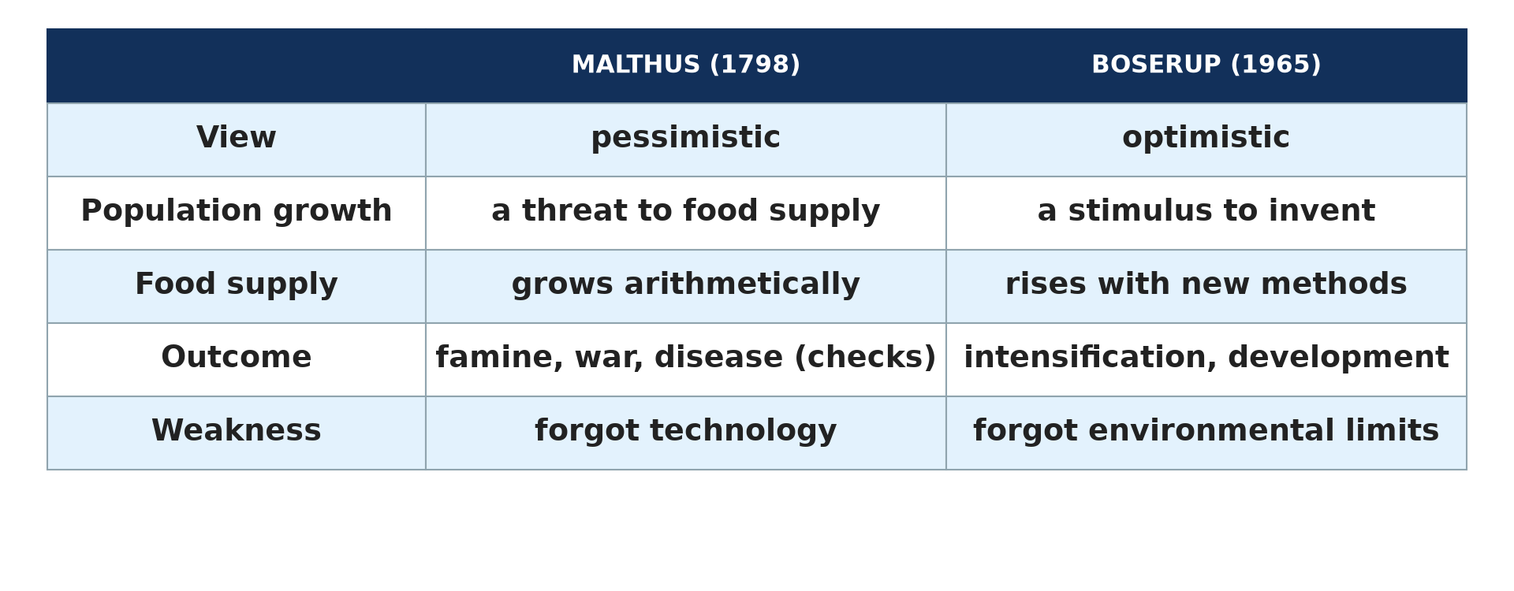
1. GENERAL VIEWS
Activity 1
Malthus and Boserup compared.
Notes:
Activity 1. Look carefully at this picture: malthus and Boserup compared. Observe every detail before I ask the question.

Slide 22
1. GENERAL VIEWS
Activity 1: Question
Which theorist has an optimistic view?
Notes:
Here is the question for Activity 1: Which theorist has an optimistic view? Take one minute to think and write your answer in your rough notebook.

Slide 23
1. GENERAL VIEWS
Activity 1: Answer
Ester Boserup.
Notes:
Let us check the answer together. Ester Boserup.

Slide 24
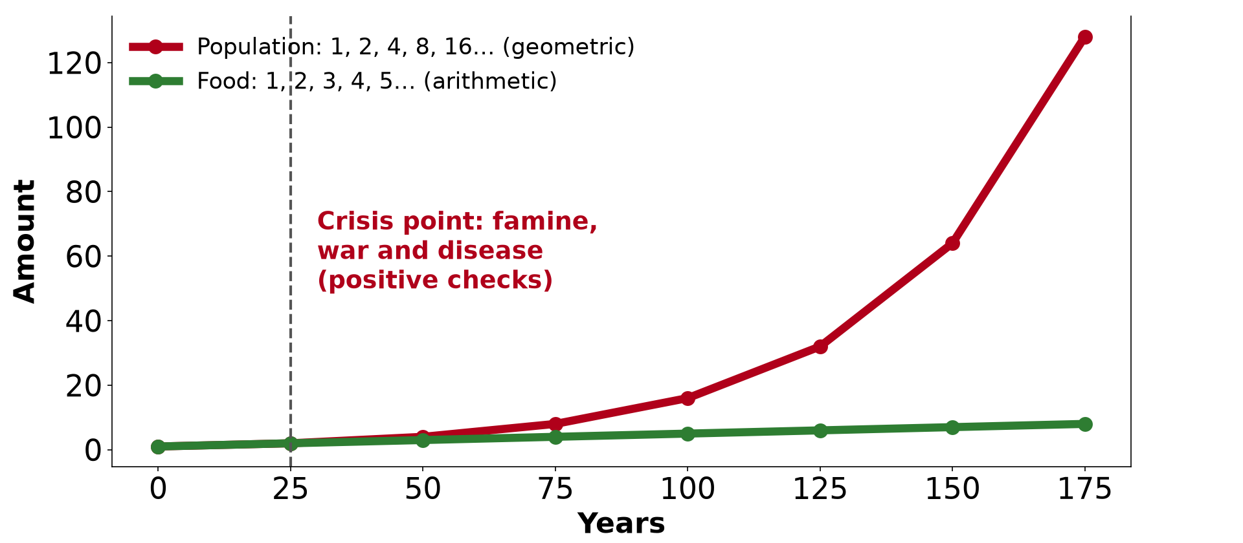
2. MALTHUS
Activity 2
Population and food according to Malthus.
Notes:
Activity 2. Look carefully at this diagram: population and food according to Malthus. Observe every detail before I ask the question.

Slide 25
2. MALTHUS
Activity 2: Question
How does food production grow according to Malthus?
Notes:
Here is the question for Activity 2: How does food production grow according to Malthus? Take one minute to think and write your answer in your rough notebook.

Slide 26
2. MALTHUS
Activity 2: Answer
Arithmetically (1, 2, 3, 4…).
Notes:
Let us check the answer together. Arithmetically (1, 2, 3, 4…).

Slide 27

2. MALTHUS
Activity 3
Drought and hunger.
Notes:
Activity 3. Look carefully at this picture: drought and hunger. Observe every detail before I ask the question.

Slide 28
2. MALTHUS
Activity 3: Question
Name one "positive check" of Malthus.
Notes:
Here is the question for Activity 3: Name one "positive check" of Malthus. Take one minute to think and write your answer in your rough notebook.

Slide 29
2. MALTHUS
Activity 3: Answer
Famine, war or disease.
Notes:
Let us check the answer together. Famine, war or disease.

Slide 30
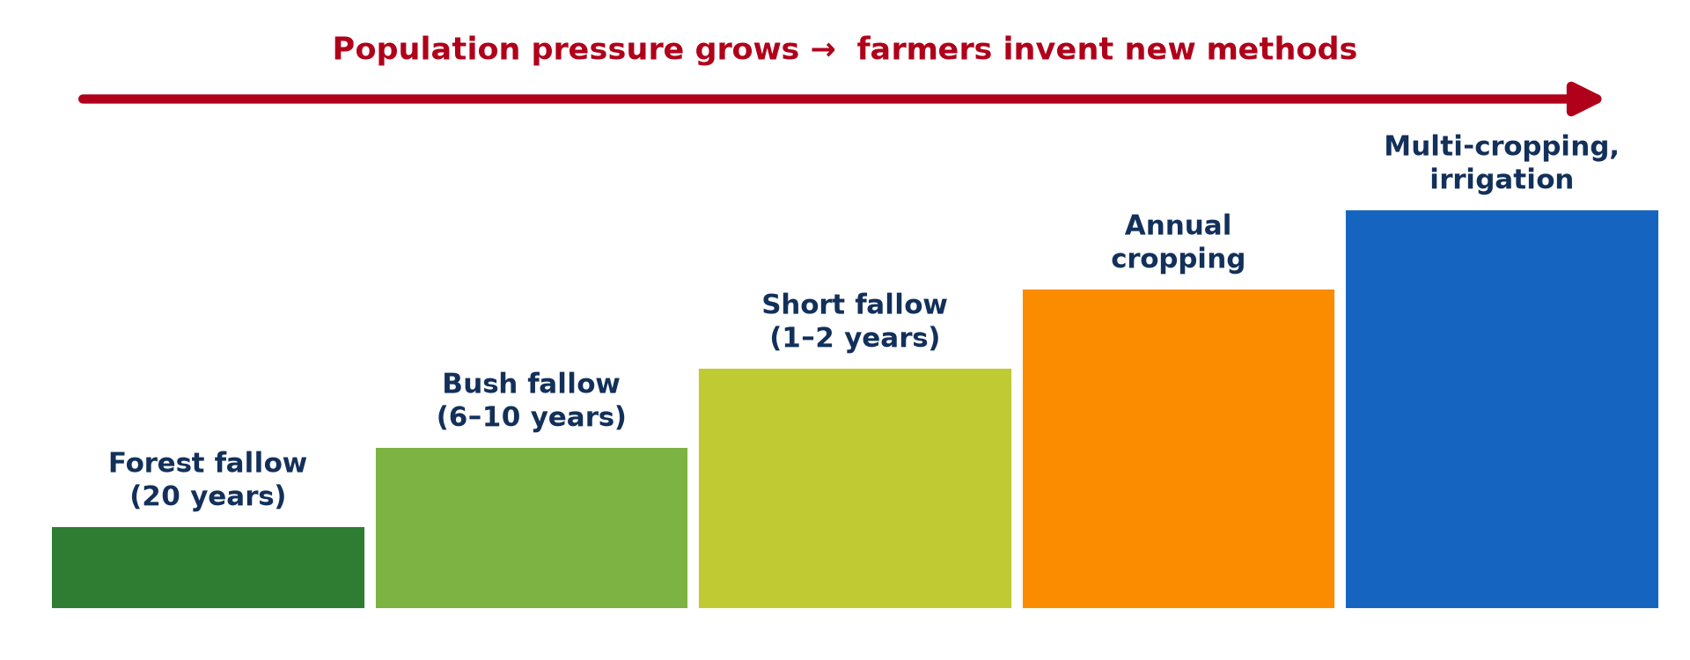
3. BOSERUP
Activity 4
From forest fallow to multi-cropping.
Notes:
Activity 4. Look carefully at this diagram: from forest fallow to multi-cropping. Observe every detail before I ask the question.

Slide 31
3. BOSERUP
Activity 4: Question
What happens to farming when population pressure grows, according to Boserup?
Notes:
Here is the question for Activity 4: What happens to farming when population pressure grows, according to Boserup? Take one minute to think and write your answer in your rough notebook.

Slide 32
3. BOSERUP
Activity 4: Answer
It is intensified: fallows are shortened and new methods are used.
Notes:
Let us check the answer together. It is intensified: fallows are shortened and new methods are used.

Slide 33

4. APPLICATION
Activity 5
The Lagdo dam.
Notes:
Activity 5. Look carefully at this picture: the Lagdo dam. Observe every detail before I ask the question.

Slide 34
4. APPLICATION
Activity 5: Question
How does the Lagdo dam illustrate Boserup's theory?
Notes:
Here is the question for Activity 5: How does the Lagdo dam illustrate Boserup's theory? Take one minute to think and write your answer in your rough notebook.

Slide 35
4. APPLICATION
Activity 5: Answer
Irrigation from the lake allows more food for a growing population.
Notes:
Let us check the answer together. Irrigation from the lake allows more food for a growing population.

Slide 36
BOARD SUMMARY
Board Summary
Topic: Population Growth and Resources
Sub-topic: Theories of Population Growth and Resources
Lesson 18: Theories of Population and Resources: Malthus and Boserup
Notes:
Now we are going to copy the board summary. Write the title and the headings neatly in your notebooks. I will give you enough time for each slide, so do not rush.

Slide 37
BOARD SUMMARY
DEFINITIONS
The key terms of this lesson are defined as follows:
Geometric progression: It is a series in which each number is multiplied by the same factor (1, 2, 4, 8, 16).
Notes:
Let us copy the definitions. The key terms of this lesson are defined as follows. On this slide we have Geometric progression. Write each point on a new line, with the key term first, and explain it in your own words when we revise. When you finish, we go to the next slide.

Slide 38
BOARD SUMMARY
DEFINITIONS (continued)
Arithmetic progression: It is a series in which the same number is added each time (1, 2, 3, 4, 5).
Checks: They are the factors that limit population growth, such as famine, war, disease or late marriage.
Notes:
We continue with the definitions. On this slide we have Arithmetic progression and Checks. Write each point on a new line, with the key term first, and explain it in your own words when we revise. When you finish, we go to the next slide.

Slide 39
BOARD SUMMARY
DEFINITIONS (continued)
Agricultural intensification: It is the increase of production on the same land through more labour, new tools and new methods.
Notes:
We continue with the definitions. On this slide we have Agricultural intensification. Write each point on a new line, with the key term first, and explain it in your own words when we revise.

Slide 40
BOARD SUMMARY
1. General Views on Population and Resources
There are two general views on population and resources:
The pessimistic view: It holds that population grows faster than resources and will cause shortages, famine and crises. Malthus and, later, the Neo-Malthusians defend this view.
Illustration: Malthus and Boserup
Notes:
Let us copy General Views on Population and Resources. There are two general views on population and resources. Copy the point on The pessimistic view on the left, then draw the diagram on the right: malthus and Boserup. Give it a title and label it clearly.

Slide 41
BOARD SUMMARY
1. General Views on Population and Resources
The optimistic view: It holds that population growth stimulates human invention, which increases resources. Boserup defends this view, summed up by the saying "necessity is the mother of invention".
Notes:
We continue with General Views on Population and Resources. Copy the point on The optimistic view: write the key term first, then its explanation.

Slide 42
BOARD SUMMARY
2. The Theory of Malthus
A) His Views
The theory of Malthus is explained as follows:
The essay: Thomas Malthus, an English clergyman, published "An Essay on the Principle of Population" in 1798. He wrote at a time of rapid population growth and poverty in England.
Illustration: the theory of Malthus
Notes:
Let us copy His Views. The theory of Malthus is explained as follows. Copy the point on The essay on the left, then draw the diagram on the right: the theory of Malthus. Give it a title and label it clearly.

Slide 43
BOARD SUMMARY
2. The Theory of Malthus
A) His Views
Population and food: Population grows in a geometric progression (1, 2, 4, 8), while food grows in an arithmetic progression (1, 2, 3, 4). Population will therefore soon exceed food supply, which blocks economic development.
Notes:
We continue with His Views. Copy the point on Population and food: write the key term first, then its explanation.

Slide 44
BOARD SUMMARY
2. The Theory of Malthus
A) His Views
Checks: Preventive checks, such as late marriage and moral restraint, can reduce births. If they fail, positive checks, such as famine, war and disease, reduce the population by force.
Illustration: drought
Notes:
Copy the point on Checks on the left, then draw the diagram on the right: drought. Give it a title and label it clearly.

Slide 45
BOARD SUMMARY
2. The Theory of Malthus
B) Strengths and Weaknesses
The theory of Malthus has the following strengths and weaknesses:
Strength: food insecurity: The theory remains useful to understand food insecurity and famines in fast-growing regions such as the Sahel. It explains why population policies are needed.
Notes:
Let us copy Strengths and Weaknesses. The theory of Malthus has the following strengths and weaknesses. Copy the point on Strength: food insecurity: write the key term first, then its explanation.

Slide 46
BOARD SUMMARY
2. The Theory of Malthus
B) Strengths and Weaknesses
Strength: limits of resources: It warns that resources such as land, water and forests are limited. Environmentalists use it to explain climate change and the exhaustion of resources.
Notes:
We continue with Strengths and Weaknesses. Copy the point on Strength: limits of resources: write the key term first, then its explanation.

Slide 47
BOARD SUMMARY
2. The Theory of Malthus
B) Strengths and Weaknesses
Weakness: technology: Malthus underestimated technology, which has greatly increased food production through fertilisers, machines and new seeds. World food production has grown faster than population since 1798.
Notes:
We continue with Strengths and Weaknesses. Copy the point on Weakness: technology: write the key term first, then its explanation.

Slide 48
BOARD SUMMARY
2. The Theory of Malthus
B) Strengths and Weaknesses
Weakness: distribution: His theory is based on pre-industrial England and did not foresee family planning. It also ignores the unequal distribution of resources, which causes more hunger than their lack.
Notes:
We continue with Strengths and Weaknesses. Copy the point on Weakness: distribution: write the key term first, then its explanation.

Slide 49
BOARD SUMMARY
3. The Theory of Boserup
A) Her Views
The theory of Boserup is explained as follows:
The book: Ester Boserup, a Danish economist, published "The Conditions of Agricultural Growth" in 1965. She studied farming systems in Africa and Asia.
Illustration: the theory of Boserup
Notes:
Let us copy Her Views. The theory of Boserup is explained as follows. Copy the point on The book on the left, then draw the diagram on the right: the theory of Boserup. Give it a title and label it clearly.

Slide 50
BOARD SUMMARY
3. The Theory of Boserup
A) Her Views
Population pressure and invention: When population grows, farmers are forced to find ways of producing more food: "necessity is the mother of invention". Forest fallow gives way to bush fallow, short fallow, annual cropping and multi-cropping, so population growth promotes economic development.
Notes:
We continue with Her Views. Copy the point on Population pressure and invention: write the key term first, then its explanation.

Slide 51
BOARD SUMMARY
3. The Theory of Boserup
A) Her Views
Example: In the North, irrigated rice around the Lagdo reservoir feeds a growing population. In the Mandara Mountains, dense populations built terraces and use manure to farm the slopes intensively.
Illustration: Lake Lagdo
Notes:
Copy the point on Example on the left, then draw the diagram on the right: lake Lagdo. Give it a title and label it clearly.

Slide 52
BOARD SUMMARY
3. The Theory of Boserup
B) Strengths and Weaknesses
The theory of Boserup has the following strengths and weaknesses:
Strength: human innovation: It shows the power of human innovation to overcome resource limits. The Green Revolution in Asia supports it.
Notes:
Let us copy Strengths and Weaknesses. The theory of Boserup has the following strengths and weaknesses. Copy the point on Strength: human innovation: write the key term first, then its explanation.

Slide 53
BOARD SUMMARY
3. The Theory of Boserup
B) Strengths and Weaknesses
Strength: real examples: It fits many countries where farming has progressed with population growth, such as the Machakos district of Kenya. Densely populated areas often have the most intensive farming.
Notes:
We continue with Strengths and Weaknesses. Copy the point on Strength: real examples: write the key term first, then its explanation.

Slide 54
BOARD SUMMARY
3. The Theory of Boserup
B) Strengths and Weaknesses
Weakness: too optimistic: Innovation does not always come in time, and some areas suffer famine before new methods are adopted. It also needs capital and education that poor farmers lack.
Notes:
We continue with Strengths and Weaknesses. Copy the point on Weakness: too optimistic: write the key term first, then its explanation.

Slide 55
BOARD SUMMARY
3. The Theory of Boserup
B) Strengths and Weaknesses
Weakness: environmental damage: Intensification can cause soil erosion, deforestation and water shortages. It also fails where there is war or no investment.
Notes:
We continue with Strengths and Weaknesses. Copy the point on Weakness: environmental damage: write the key term first, then its explanation.

Slide 56
BOARD SUMMARY
4. Comparison and Application Today
The two theories compare and apply today as follows:
Population growth and development: For Malthus, population growth is a threat that hinders development. For Boserup, it is a stimulus that promotes development through technology.
Notes:
Let us copy Comparison and Application Today. The two theories compare and apply today as follows. Copy the point on Population growth and development: write the key term first, then its explanation.

Slide 57
BOARD SUMMARY
4. Comparison and Application Today
Developing countries: In sub-Saharan Africa, rapid growth causes food shortages, which supports Malthus. However, innovations such as improved seeds and irrigation support Boserup.
Notes:
We continue with Comparison and Application Today. Copy the point on Developing countries: write the key term first, then its explanation.

Slide 58
BOARD SUMMARY
4. Comparison and Application Today
Developed countries: Climate change and over-consumption have revived Malthusian fears about the limits of the Earth. Neo-Malthusians warn that resources are being exhausted.
Notes:
We continue with Comparison and Application Today. Copy the point on Developed countries: write the key term first, then its explanation.

Slide 59
BOARD SUMMARY
4. Comparison and Application Today
A balanced view: Neither theory is fully right. Good policies combine the control of population growth with innovation and the conservation of resources.
Notes:
We continue with Comparison and Application Today. Copy the point on A balanced view: write the key term first, then its explanation.

Slide 60
FORMATIVE EVALUATION
Evaluation 1
State the main difference between Malthus and Boserup.
Notes:
Now let us check what you have understood. Question 1: State the main difference between Malthus and Boserup. Answer in your exercise book.

Slide 61
FORMATIVE EVALUATION
Expected Answer
Malthus thinks population growth leads to famine; Boserup thinks it leads to agricultural innovation.
Notes:
The expected answer is: malthus thinks population growth leads to famine; Boserup thinks it leads to agricultural innovation. If you got it right, well done.

Slide 62
FORMATIVE EVALUATION
Evaluation 2
Give one weakness of each theory.
Notes:
Now let us check what you have understood. Question 2: Give one weakness of each theory. Answer in your exercise book.

Slide 63
FORMATIVE EVALUATION
Expected Answer
Malthus underestimated technology; Boserup is too optimistic and ignores environmental limits.
Notes:
The expected answer is: malthus underestimated technology; Boserup is too optimistic and ignores environmental limits. If you got it right, well done.

Slide 64
REMEDIATION
Remediation
Fill in the blanks:
Malthus published his essay in ______.
According to Malthus, food grows ______.
Boserup's theory is ______.
Notes:
For those who need more practice, fill in the blanks in your exercise book. The answers are: number 1, 1798; number 2, arithmetically; number 3, optimistic.

Slide 65
HOMEWORK
Homework
State the population of Cameroon at the 2005 census.
Notes:
For your homework: State the population of Cameroon at the 2005 census. We shall correct it at the beginning of our next lesson.

Slide 66
NEXT LESSON
Next Lesson
Our next lesson will be on:
Further Study 1: Population Change in Cameroon
Notes:
Our next lesson will be on Further Study 1: Population Change in Cameroon. Thank you for your attention, and see you next time.

Slide 67
BILINGUAL GAME
Bilingual Game (Jeu Bilingue)
English | Français
Population growth | La croissance démographique
Resources | Les ressources
Theory | La théorie
Famine | La famine
Invention | L'invention
Intensification | L'intensification
Notes:
Let us play the bilingual game. I say a word in English, and you give me the French word. Then we do the reverse.

Slide 68
LOGBOOK
Official Logbook (1/2)
Module / Topic | Population Growth and Resources
Lesson Title | Lesson 18: Theories of Population and Resources: Malthus and Boserup
Expected Learning Outcomes | Distinguish the pessimistic and optimistic views. Explain Malthus's theory and appraise it. Explain Boserup's theory and appraise it. Compare the two theories. Apply them to present-day issues.
Competence | Learners are able to explain, compare and criticise the theories of Malthus and Boserup and apply them to North Cameroon.
Notes:
I record this information in the official logbook of the class after the lesson.

Slide 69
LOGBOOK
Official Logbook (2/2)
Matter Taught | DEFINITIONS; General Views on Population and Resources; His Views; Strengths and Weaknesses; Her Views; Comparison and Application Today.
Evaluation | Formative evaluation and remediation exercise.
Homework | State the population of Cameroon at the 2005 census.
Enrolment / Present / Absent | ____ / ____ / ____
Achievement | To be completed after the lesson.
Notes:
I complete the second page of the logbook: the matter taught, the evaluation, the homework and the attendance.

Slide 70
TEACHER'S NOTE
Teacher's Note
Timing: Homework correction, plan, objectives 8 min | Recall, situation, action 10 min | 5 activities 30 min | Board summary (copying) 30 min | Evaluation, remediation 10 min | Homework, next lesson 5 min | Logbook 7 min
Without the projector (Activity 1): draw the comparison table.
Without the projector (Activity 2): write the two series on the board.
Without the projector (Activity 3): discuss food crises in the Sahel.
Without the projector (Activity 4): draw the staircase.
Without the projector (Activity 5): describe irrigated rice at Lagdo.
Notes:
This slide is for me, the teacher: it gives the timing of the lesson and what to do if the projector is not available.

Slide 71
REFERENCES
References
Geography Syllabus for Sixth Forms (Lower and Upper Sixth), MINESEC, 2019 — Module 4 (Population Geography).
Teacher's course notes: Mr KAMDEM E., Population Geography (USA), GBHS Garoua, 2026.
United Nations, World Population Prospects 2024.
Photo, Activity 3: “Imagine a world without trees” by aloshbennett, CC BY 2.0, via Flickr (https://www.flickr.com/photos/13203757@N00/3480223314)
Photo, Activity 5: “South Holston Lake, (Virginia-Tennessee border, USA)” by James St. John, CC BY 2.0, via Flickr (https://www.flickr.com/photos/47445767@N05/39221734762)
Diagrams and animations: drawn for this lesson (Geography Department).
Notes:
These are the references and picture credits used to prepare this lesson.

